Slide 1
Global Trends in Legislative Ethics: Presentation to Members of
Costa Rican Legislative Assembly
Richard E Messick
October 3, 2019
messickrick@gmail.com

Slide 2
Types of Ethical Norms
High level principles
  “Selflessness: Holders of public office should act solely in terms of the public interest. They should not do so to gain financial or other benefits for themselves, their family or their friends.”
Detailed rules
  Compliance: “A Member, officer, or employee may accept an offer of ‘free attendance’ at a widely attended event if: (1) invited by the organizing event sponsor; (2) at least 25 persons from outside Congress will be attendance, (3) attendance at the event is open to members from throughout a given industry or profession, or to a range of persons interested in an issue; and (4) it is connected to the official’s Senate duties”

Slide 3
Sources of Legislative Ethics
Constitution
  articles 111 & 112
Statutes
  articles 21- 23 corruption/illicit enrichment law
Ethics Code
  acuerdo 53-13-14 for staff
Notes:
111 is incompatibilities; 112 is can’t hold government contracts or concessions
21- 23: IAD

Slide 4
Values: Common Themes
Impartiality
Legality
Reliability
Equal Treatment
Integrity
Professionalism
Source: Bo Rothstein and Nicholas Sorak, Ethical Codes for The Public Administration: A Comparative Survey, 2017

Slide 5
Values: UK Principles of Public Life
Selflessness
Integrity
Objectivity
Accountability
Openness
Honesty
Leadership

Slide 6
Values: Belize
Legislators should not:
place themselves in conflict of interest situations
compromise fair exercise of their functions and duties
use their office for private gain
demean their office or position
allow their integrity to be questioned
endanger respect for, or confidence in, government’s integrity

Slide 7
Detailed Rules
Conflicts of interest | Floor crossing
Gifts | Discrimination
Use government resources | Enforcement
Lobbying | Immunities
Transparency | Political contributions

Slide 8
Legislators: Representatives? Public Servants?
Voters wishes “ought to have great weight with him; their opinion, high respect; their business, unremitted attention. . . . . But his unbiassed opinion, his mature judgment, his enlightened conscience, he ought not to sacrifice to you, to any man, or to any set of men living. . . . Your representative owes you, not his industry only, but his judgment . . . he betrays . . .you if he sacrifices it to your opinion.
Edmund Burke, speech to voters, 1774

Slide 9
Conflict of Interest
Los colaboradores de la Asamblea Legislativa deben asegurar su independencia y objetividad, evitando caer en situaciones que pongan en duda dicha condición. Se abstendrán de participar en cualquier proceso decisorio, incluso en su fase previa de consultas e informes, cuando su vinculación con actividades externas de alguna forma pueda verse afectada por la decisión oficial, o pueda comprometer su criterio o dar ocasión de duda sobre su imparcialidad y conducta ética a cualquier persona razonablemente objetiva. Igualmente debe apartarse cuando dichas decisiones afectan a personas allegadas como su cónyuge, hermano, ascendiente o descendiente hasta el segundo grado de consanguinidad o afinidad inclusive; o un socio o persona jurídica.
Código De Ética Y Conducta De La Asamblea: Legislativa Ideas Rectoras Institucionales, Gaceta No. 17 del 24 de Enero del 2014, Acuerdo No. 53-13-14

Slide 10
Conflict of Interest: Voting
Prohibition
  U.S. House of Representatives: “Every Member . . . shall vote on each question put, unless he has a direct personal or pecuniary interest in the event of such question.”
Disclosure
  U.K. House of Commons: Members “shall always be open and frank in drawing attention to any relevant interest in any proceeding of the House or its Committees.”
Notes:
Interpretation: “The disqualifying interest must be such as affects the Member directly, and not as one of a class. . . .” Members with stock in national bank may vote on banking legislation since they “do not have that interest separate and distinct from a class, and, within the meaning of the rule, distinct from the public interest.” Likewise, military veterans can vote on military pension issues and those with stocks in breweries or distilleries allowed to vote on proposed Constitutional amendment banning manufacture and sale of liquor.

Slide 11
Conflict of Interest: Representation v. Public Servant
Oakland Ca. Mayor Jerry Brown
Assembly Member Evita Arguedas
Pledged if elected to invest public monies in West Oakland
Independent regulator ruled it would be conflict of interest as he owned apartment there
Court of appeals reversed: “broad scope of the mayor's authority over matters of economic development requires a relatively broad exemption” from conflict rule
Lawyer expert in telecommunications issues
Named head of special assembly commission to reform telecommunications law
La Procuraduría General de la República le recomienda . . . [ella] “abstenerse de participar”, en la comisión legislativa que analiza el proyecto de ley general de telecomunicaciones.”

Slide 12
Gift Rules
U.S. Senate: “Report all gifts received by you, your spouse, or your dependent children from any one source during the reporting period that aggregated more than $390 in value.”
Exclude –
Anything received from a father, mother, son, daughter, brother, sister, uncles and aunts cousins, nephews, in-laws, step parents and children, spouse’s grandparents and a fiancé or fiancée
Bequests and other forms of inheritance;
Food and beverages not consumed in connection with a gift of overnight lodging;
Anything given to a spouse or dependent child totally independent of their relationship to you and without your knowledge and acquiescence;
Food, lodging, transportation, and entertainment provided by a government or by an individual, other than a registered lobbyist or foreign agent, at that person’s residence

Slide 13
Discrimination
“A Member . . . officer, or employee of the House may not discharge and may not refuse to hire an individual, or otherwise discriminate against an individual with respect to compensation, terms, conditions, or privileges of employment, because of the race, color, religion, sex . . . , sexual orientation, gender identity, disability, age, or national origin of such individual.”
“A Member . . . officer, or employee of the House may not engage in unwelcome sexual advances or conduct towards another Member, Delegate, Resident Commissioner, officer, or employee of the House.”
U.S. House of Representatives, Code of Official Conduct

Slide 14
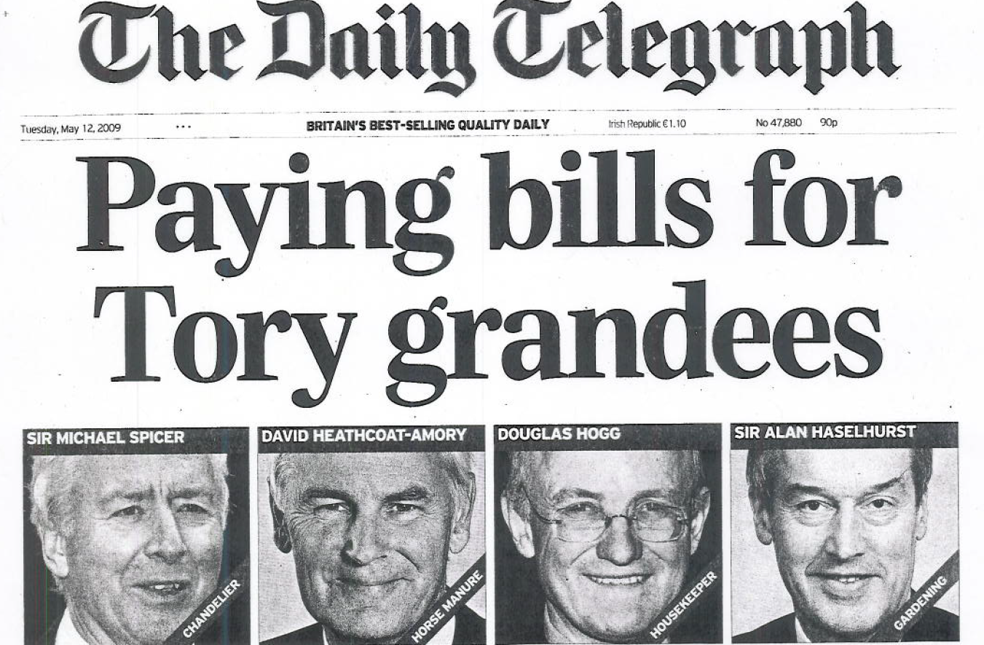
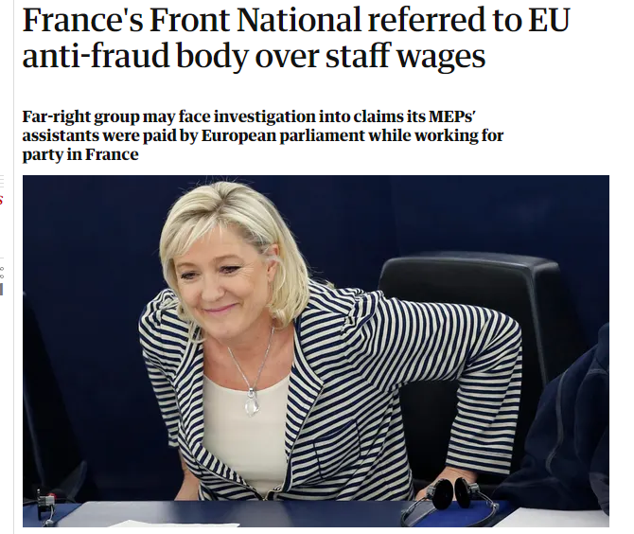
Use government resources
Allowances
Employment

Slide 15
Floor Crossing
“A member of the House of Representatives shall also vacate his seat in the House . . . if, having been a candidate of a political party and elected to the House of Representatives as a candidate of that political party, he resigns from that political party or crosses the floor.”
Article 59, Constitution of Belize

Slide 16
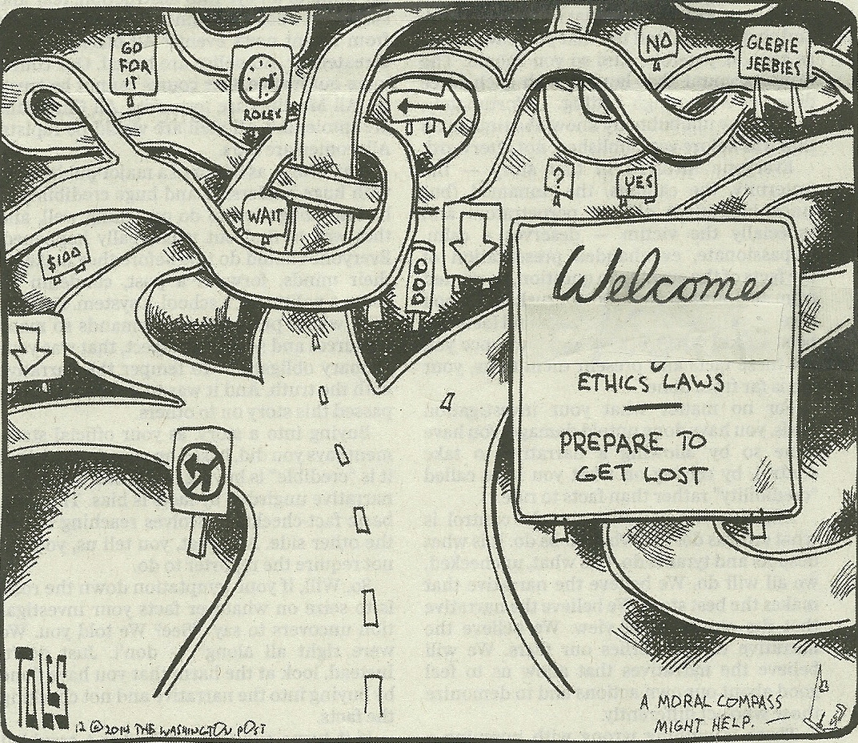
Detailed Rules

Slide 17

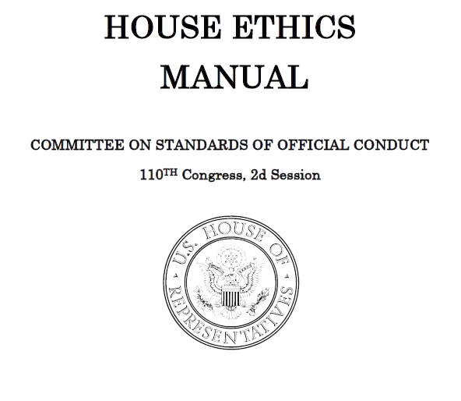
Guides
283 pages
456 pages

Slide 18
Lobbying
aquella gestión o actividad remunerada, ejercida por personas naturales o jurídicas, chilenas o extranjeras, que tiene por objeto promover, defender o representar cualquier interés particular, para influir en las decisiones que, en el ejercicio de sus funciones, deban adoptar los sujetos pasivos que se indican en los artículos 3º y 4º.
Ley Núm. 20.730, Regula El Lobby Y Las Gestiones Que Representen Intereses Particulares Ante Las Autoridades y Funcionarios

Slide 19
Lobbying Regulation: Principles
Transparency
  Disclose a) who lobbies and b) who is lobbied
Integrity
  Ethics codes for lobbyists
  Cooling off period for legislators
Equality of access
  Consultation/public participation mechanisms
Transparency International, Lobbying in Europe: Hidden Influences, Privileged Access,2015

Slide 20
Transparency: Who Lobbies
European Union and U.S.
  Organization name & address
  Individuals who lobby
  Issues on which they lobby
U.S.
  Clients
  Affiliated organizations
  Political contributions

Slide 21
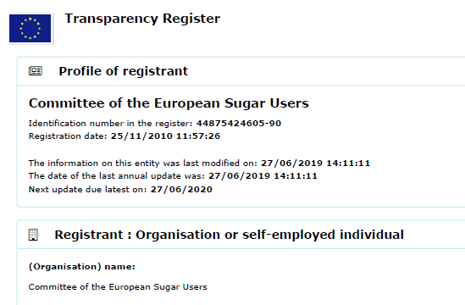
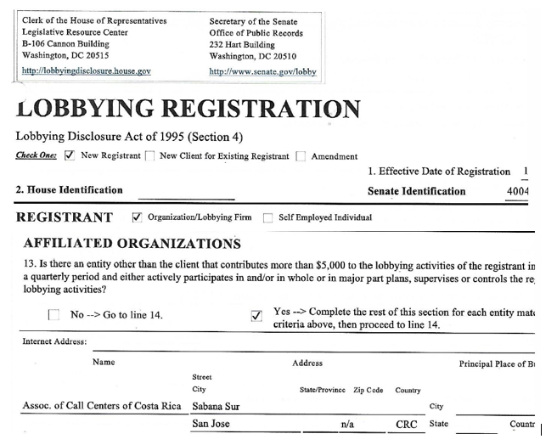
Transparency: Lobbyist Registration

Slide 22
Transparency: Who is Lobbied
Art. 7: Dos registros, cada uno a cargo de las respectivas Comisiones de Ética y Transparencia Parlamentaria, en los que deberá incorporarse la información por los sujetos pasivos señalados en el numeral 5) del artículo 4º
Art. 4(5): En el Congreso Nacional: los diputados, los senadores, el Secretario General y el Prosecretario de la Cámara de Diputados, el Secretario General y el Prosecretario Tesorero del Senado, y los asesores legislativos que indique anualmente cada parlamentario, en la forma y con el procedimiento que determine la Comisión de Ética y Transparencia Parlamentaria que corresponda

Slide 23
Transparency: Details of Lobbying
Las audiencias y reuniones sostenidas y que tengan por objeto el lobby o la gestión de intereses particulares respecto de las decisiones que se señalan en el artículo 5º. En dichos registros se deberá indicar, en particular, la persona [ou] organización con quien se sostuvo la audiencia o reunión, a nombre de quién se gestionan dichos intereses particulares, la individualización de los asistentes o personas presentes en la respectiva audiencia o reunión, si se percibe una remuneración por dichas gestiones, el lugar y fecha de su realización y la materia específica tratada.

Slide 24
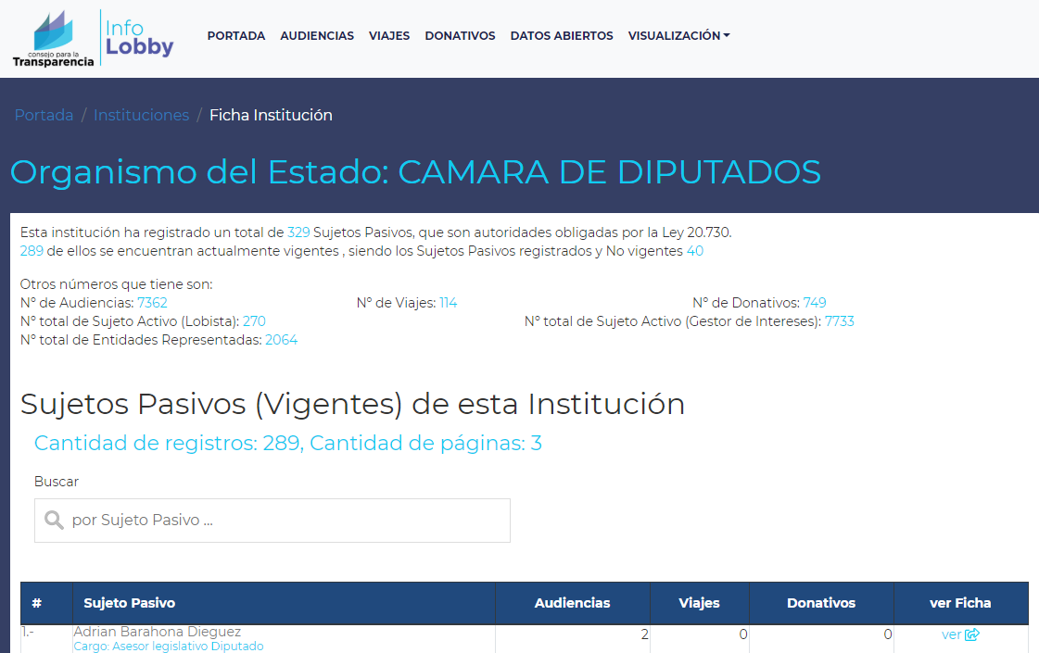

Slide 25
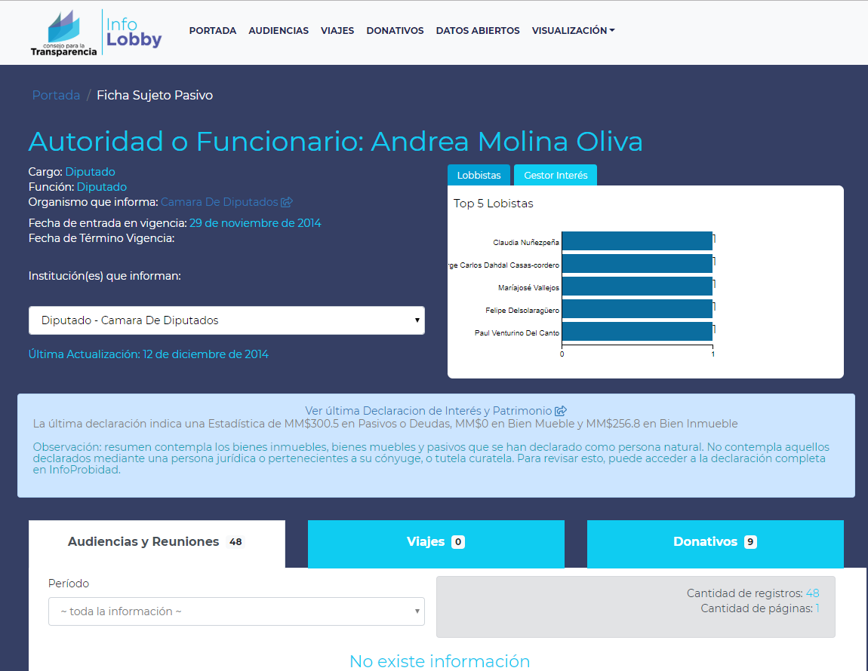

Slide 26
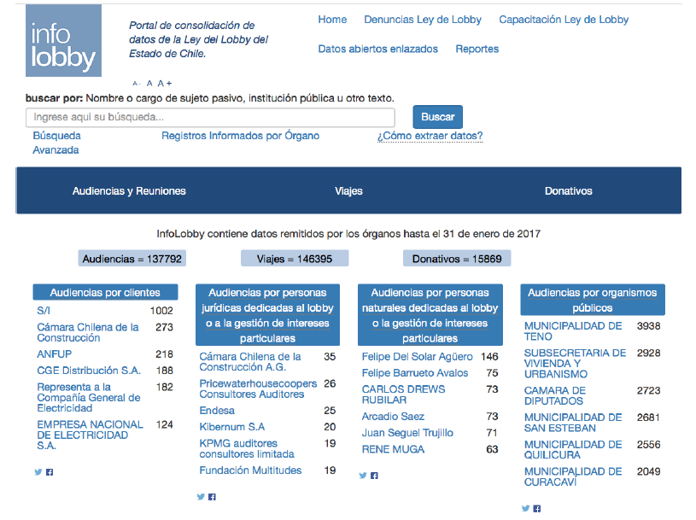
Lobbyist and Lobbied Reporting
http://infolobby.cl

Slide 27
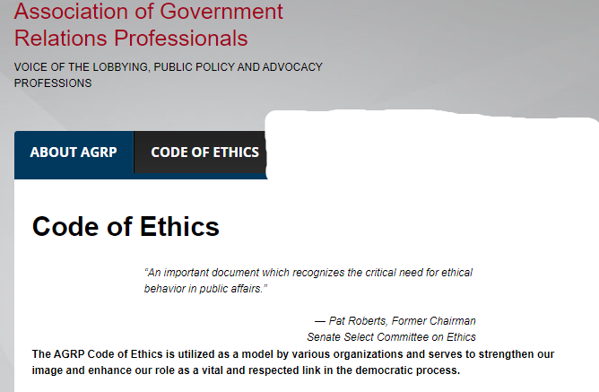

Lobbying Integrity: Ethics Codes

Slide 28
Lobbying Integrity
Código de Buenas Prácticas para Lobbistas
Principios Honestidad e integridad
Sujeción a la normativa vigente
Relación con el cliente
Relación con la autoridad
Conflictos de intereses

Slide 29
Lobbying Integrity
Principios: Compatibilidad del interés privado y el interés público. Los lobbistas promoverán, defenderán o representarán los intereses particulares de los clientes procurando no contravenir el interés general de la comunidad.
Conflictos de intereses: El lobbista se abstendrá de contratar a personas que a ex autoridades o ex funcionarios durante dos años luego de que estos hayan cesado en sus funciones. (puertas giratorias)

Slide 30
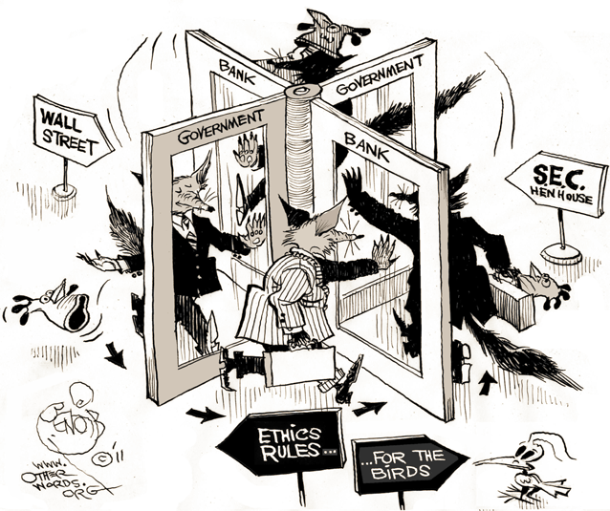
Revolving Door

Slide 31
Enforcement: Entity
  Principles: effective, impartial, credible
  Options -
  Self-regulation
      Whitewashing/circling the wagons
      Partisanship
  Court or other independent entity
      Independence
      Speed
  Combination
      Investigation by independent entity, judgement by committee or entire body
      Confidence of body in entity

Slide 32
Enforcement: Sanctions
    Informal letter of admonition
    Reprimand
    Censure
    Fine
    Expulsion
Jack Maskell, Expulsion, Censure, Reprimand, and Fine: Legislative Discipline in the House of Representatives, Congressional Research Service, June 27, 2016

Slide 33
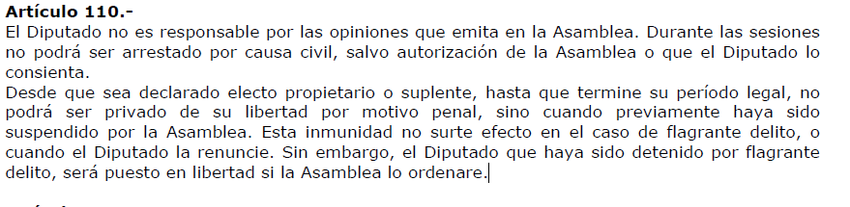
Immunities: Costa Rica

Slide 34
Immunities: Non-liability
    Legislator cannot be detained or prosecuted for votes cast or opinions expressed while discharging legislative duties
  Protects legislative independence
  “The Freedom of Speech, and Debates or Proceedings in Parliament, ought not to be impeached or questioned in any Court or Place out of Parliament.” English Bill of Rights, 1689
Notes:
“protecting against possible prosecution by an unfriendly executive and conviction by a hostile judiciary, is one manifestation of the "practical security" for ensuring the independence of the legislature.” United States v. Johnson, 383 U.S. 169, 179 (1966)

Slide 35
Immunities: Inviolability
    Legislator cannot be detained or prosecuted for any act without express approval of parliament
  Protects legislative independence
  UNCAC article 30: “Each state shall . . . maintain an appropriate balance between any immunities or jurisdictional privileges accorded to its public officials. . . and the possibility . . . of effectively investigating, prosecuting and adjudicating offenses established in accordance with this Convention.”
Notes:
“protecting against possible prosecution by an unfriendly executive and conviction by a hostile judiciary, is one manifestation of the "practical security" for ensuring the independence of the legislature.” United States v. Johnson, 383 U.S. 169, 179 (1966)

Slide 36
Selected Resources
National Democratic Institute for International Affairs, Legislative Ethics: A Comparative Analysis, 1999.
GOPAC, Handbook on Parliamentary Ethics and Conduct: A Guide for Parliamentarians, Westminster Foundation for Democracy, n.d.
European Parliament, Parliamentary Ethics: A Question of Trust, Office for Promotion of Parliamentary Democracy 2011.
Commonwealth Parliamentary Association, Recommended Benchmarks for Codes of Conduct Applying to Members of Parliament, n.d.
Alan Rosenthal, Drawing the Line: Legislative Ethics in the States, Lincoln: University of Nebraska Press, 1999.
David Hine David and Gillian Peele, The Regulation of Standards in British Public Life: Doing the Right Thing? Manchester: Manchester University Press, 2016.

